Slide 1
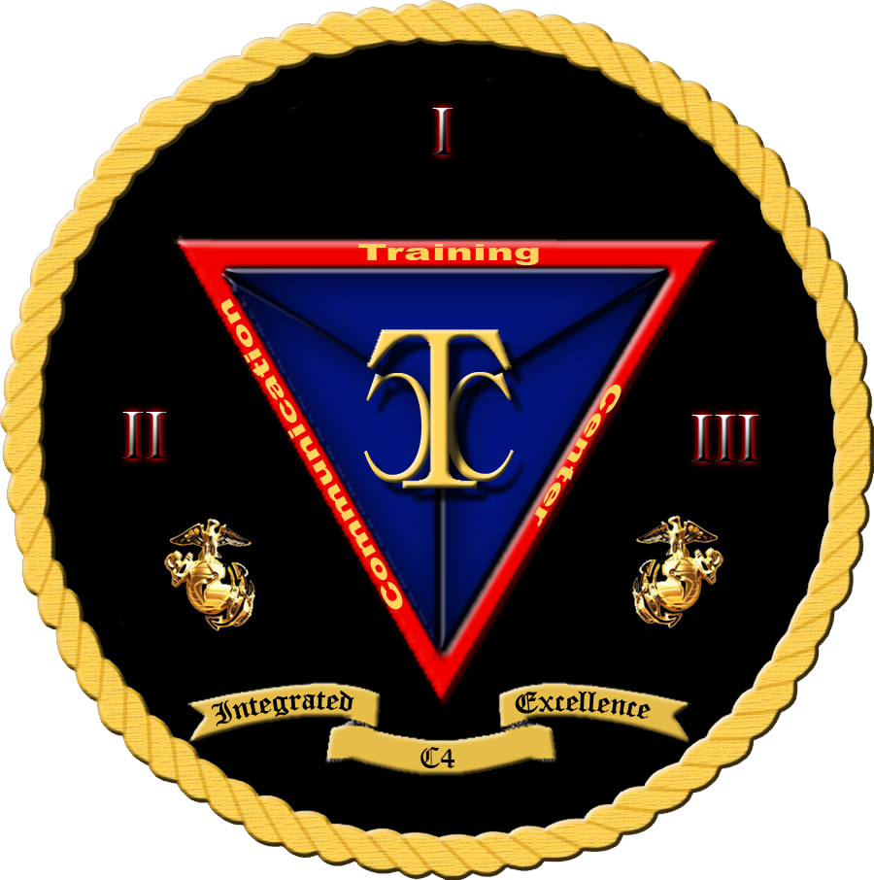
Security+
Exam SY0-601
Chapter 32
Regulations, Standards, and Frameworks
Notes:
Gain Attention

Slide 2
Chapter 32 (Domain 5.2) Learning Objectives
Explain the importance of applicable regulations, standards, or frameworks that impact organizational security posture.
Regulations, standards, and legislation
General Data Protection Regulation (GDPR)
National, territory, or state laws
Payment Card Industry Data Security Standard (PCI DSS)
Key frameworks
Center for Internet Security (CIS)
National Institute of Standards and Technology (NIST) Risk Management Framework (RMF)/Cybersecurity Framework (CSF)
International Organization for Standardization (ISO) 27001/27002/27701/31000
SSAE SOC 2 Type I/II
Cloud security alliance
Cloud control matrix
Reference architecture
Benchmarks/secure
Configuration guides
Platform/vendor-specific guides
Web server
OS
Application server
Network infrastructure devices

Slide 3
Regulations, Standards, and Frameworks
Business operations never happen in a vacuum; there are at least some policies and procedures one must follow.
But these policies and procedures get their direction from regulations, standards, and legislation.
Laws are made by the legislative bodies of government to create a specified set of conditions and penalties.
Government agencies develop and issue regulations to implement the laws.
Standards are sets of consensus-built specifications for products, services, or systems.
A wide range of different bodies create standards, and whether or not one wishes to follow them is a business decision.
Laws and regulations must be followed; otherwise, the consequences specified within them can be invoked by the government.

Slide 4
General Data Protection Regulation (GDPR)
The General Data Protection Regulation (GDPR), which was a sweeping rewrite of European privacy regulations, went into effect in May of 2018.
For all firms that wish to trade with the EU, there is now a set of privacy regulations that will require specific programs to address the requirements.

Slide 5
General Data Protection Regulation (GDPR)
The GDPR brings many changes—one being the appointment of a Data Protection Officer (DPO).
This role may be filled by an employee or a third-party service provider (for example, a consulting or law firm), and it must be a direct report to the highest management level.
The DPO should operate with significant independence, and provisions in the GDPR restrict control over the DPO by management.

Slide 6
General Data Protection Regulation (GDPR)
The GDPR requires significant consideration, including the following:
Assess personal data flows from the EU to the U.S. to define the scale and scope of the cross-border privacy-compliance challenge.
Assess readiness to meet model clauses, remediate gaps, and organize audit artifacts of compliance with the clauses.
Update privacy programs to ensure they are capable of passing an EU regulator audit.
Conduct EU data-breach notification stress tests.
Monitor changes in EU support for model contracts and binding corporate rules.

Slide 7
General Data Protection Regulation (GDPR)
The GDPR specifies requirements regarding consent, and they are significantly more robust than previous regulations. Consent requirements are also delineated for specific circumstances:
Informed/affirmative consent to data processing. Specifically, “a statement or a clear affirmative action” from the data subject must be “freely given, specific, informed and unambiguous.”
Explicit consent to process special categories of data. Explicit consent is required for “special categories” of data, such as genetic data, biometric data, and data concerning sexual orientation.
Explicit parental consent for children’s personal data.
Consent must be specific to each data-processing operation, and the data subject can withdraw consent at any time.

Slide 8
General Data Protection Regulation (GDPR)
The GDPR provides protections for new individual rights, and these may force firms to adopt new policies to address these requirements.
The rights include:
The Right to Information,
The Right to Access,
The Right to Rectification,
The Right to Restrict Processing,
The Right to Object,
The Right to Erasure,
and The Right to Data Portability.

Slide 9
General Data Protection Regulation (GDPR)
Each of these rights is clearly defined with technical specifics in the GDPR.
The GDPR also recognizes the risks of international data transfer to other parties and has added specific requirements that data protection issues be addressed by means of appropriate safeguards, including Binding Corporate Rules (BCRs), Model Contract Clauses (MCCs), also known as Standard Contractual Clauses (SCCs), and legally binding documents.
These instruments must be enforceable between public authorities or bodies, as well as all who handle data.

Slide 10
National, Territory, or State Laws
Laws are the system of rules, or statutes, made by the government of a country, state, or city.
Statutes are enacted by a legislative body and then signed by the ranking official (president/governor).
With respect to cybersecurity, there are a wide variety of laws from the national and state levels.
Computer trespass is the unauthorized entry into a computer system via any means, including remote network connections.

Slide 11
National, Territory, or State Laws
These crimes have introduced a new area of law that has both national and international consequences.
For crimes that are committed within a country’s borders, national laws apply.
For cross-border (trans-border) crimes, international laws and international treaties are the norm.
Computer-based trespass can occur even if countries do not share a physical border.

Slide 12
National, Territory, or State Laws
Computer trespass is treated as a crime in many countries.
National laws against computer trespass exist in countries such as Canada, the United States, and the member states of the European Union (EU).
Unauthorized entry and use of computer resources is treated as a crime with significant punishments.
In the future, an international treaty may pave the way for closer cooperation.

Slide 13
National, Territory, or State Laws
The Electronic Communications Privacy Act (ECPA) of 1986 addresses a myriad of legal privacy issues that resulted from the increasing use of computers and other technology specific to telecommunications.
Sections of this law address e-mail, cellular communications, workplace privacy, and a host of other issues related to communicating electronically.
Section I was designed to modify federal wiretap statutes to include electronic communications.
Section II, known as the Stored Communications Act (SCA), was designed to establish criminal sanctions for unauthorized access to stored electronic records and communications.
Section III covers pen registers and tap and trace issues.
Tap and trace information is related to who is communicating with whom, and when.
Pen register data is the conversation information.

Slide 14
National, Territory, or State Laws
A major provision of ECPA was the prohibition against an employer’s monitoring an employee’s computer usage, including e-mail, unless consent is obtained (for example, clicking Yes on a warning banner is considered consent).
Other legal provisions protect electronic communications from wiretap and outside eavesdropping, as users are assumed to have a reasonable expectation of privacy and afforded protection under the Fourth Amendment to the Constitution.
It is of note that these constitutional protections only apply to searches and seizures by U.S. government agencies and law enforcement (federal, state, or local jurisdiction), but do not apply to private individuals or employers.

Slide 15
National, Territory, or State Laws
The Computer Fraud and Abuse Act (CFAA) of 1986—amended in 1994 and 1996, in 2001 by the USA PATRIOT Act, and in 2008 by the Identity Theft Enforcement and Restitution Act—serves as the current foundation for criminalizing unauthorized access to computer systems.
CFAA makes it a crime to knowingly access a computer that is either considered a government computer or used in interstate commerce, or to use a computer in a crime that is interstate in nature, which in today’s Internet-connected age can be almost any machine.
The act also makes it a crime to knowingly transmit a program, code, or command that results in damage, aka malware.
Trafficking in passwords or similar access information is also criminalized.

Slide 16
National, Territory, or State Laws
Sarbanes-Oxley Act (SOX) of 2002:
Overhaul the financial accounting standards for publicly traded firms in the United States.
The most prominent changes was the provision of Section 404 controls, which specify that all processes associated with the financial reporting of a firm must be controlled and audited on a regular basis.
This places internal auditors into the IT shops.
Controls have resulted in controversy over the cost of maintaining them versus the risk of not using them.

Slide 17
National, Territory, or State Laws
Sarbanes-Oxley Act (SOX) of 2002:
Section 404 requires firms to establish a control-based framework designed to detect or prevent fraud that would result in misstatement of financials.
In simple terms, these controls should detect insider activity that would defraud the firm.
This has significant impacts on the internal security controls, because a system administrator with root-level access could perform many if not all tasks associated with fraud and would have the ability to alter logs and cover their tracks.
Likewise, certain levels of power users of financial accounting programs would also have significant capability to alter records.

Slide 18
National, Territory, or State Laws
There are a myriad of additional laws covering things such as privacy, digital signatures, medical records, and spam.
California Senate Bill 1386 (SB 1386) was a landmark law concerning information disclosures.
It mandates that Californians be notified whenever PII is lost or disclosed.
49 other states have similar bills
California extended its privacy laws with the California Consumer Privacy Act in 2020.

Slide 19
National, Territory, or State Laws
California extended its privacy laws with the California Consumer Privacy Act in 2020.
This act requires organizations to obtain consent from individuals to collect and use their data. It also requires them to disclose how the data is used.
It grants consumers the right to request that a business disclose:
the categories and specific pieces of information it collects,
the sources of that information,
the reasons why the business collects and/or sells that information,
and the categories of the third parties that info is shared with.
In many ways, this act mirrors the EU’s GDPR.

Slide 20
Payment Card Industry Data Security Standard (PCI DSS)
The Payment Card Industry Data Security Standard (PCI DSS) is a set of contractual rules governing how credit card data is to be protected.
Established by the big credit card companies
MasterCard, Visa, American Express, and Discover
PCI DSS is a voluntary, private sector initiative that is proscriptive in its security guidance.
Merchants and vendors can choose not to adopt these measures, but the standard has a steep price for noncompliance; the transaction fee for noncompliant vendors can be significantly higher, fines up to $500,000 can be levied, and in extreme cases the ability to process credit cards can be revoked.

Slide 21
Payment Card Industry Data Security Standard (PCI DSS)
PCI DSS has two defined types of information:
cardholder data
sensitive authentication data.
The Payment Card Industry Data Security Standard (PCI DSS) protects customer credit card information and is designed to reduce fraud.
The contractual standard has a steep financial penalty for noncompliance.

Slide 22
Key Frameworks
Frameworks provide a means of assessing the path through the maze of regulatory requirements and how they relate to risk management.
One of the challenging aspects of cybersecurity operations is determining where one should concentrate efforts, how resources should be deployed, and what balance of emphasis to place between short-term and long-term items to optimize efforts on risk mitigation.
Several types of key frameworks can be used as part of this analysis.
In the following sections, we will look at frameworks from the Center for Internet Security, the National Institute of Standards and Technology, several ISO standards, SSAE standards, and the Cloud Security Alliance.

Slide 23
Center for Internet Security (CIS)
The Center for Internet Security (CIS) is a nonprofit organization that serves the cybersecurity community in a number of ways.
It is the guardian of the CIS controls—a set of the top 20 security controls that should be implemented as a baseline of cybersecurity risk management.
This set of controls, developed in a consensus manner over the past decade, provides a roadmap of which security controls should be implemented first, second, and so on.
These prescriptive items represent the best practices across a wide range of entities, from government to industry, and are implementable by virtually any size entity.

Slide 24
National Institute of Standards and Technology (NIST) Risk Management Framework (RMF)/Cybersecurity Framework (CSF)
The National Institute of Standards and Technology (NIST) provides recommended strategies to the U.S. government and others on how to handle a wide range of issues, including risk from cybersecurity issues.
The approach taken by NIST is one built around the management of organizational risk through a risk management framework (RMF) associated with cybersecurity activities.
The NIST RMF is composed of more than 10 publications, spanning virtually every activity associated with cybersecurity.

Slide 25
National Institute of Standards and Technology (NIST) Risk Management Framework (RMF)/Cybersecurity Framework (CSF)
A second activity published by NIST is the Cybersecurity Framework (CSF).
The CSF is designed to assist organizations in the early stages of planning their cybersecurity posture.
It breaks down the types of activities into five different functions: identify, protect, detect, respond, and recover.
The CSF was mandated by a congressional bill in 2014 that directed NIST to identify “a prioritized, flexible, repeatable, performance based, and cost-effective approach, including information security measures and controls that may be voluntarily adopted by owners and operators of critical infrastructure to help them identify, assess, and manage cyber risks.”

Slide 26
National Institute of Standards and Technology (NIST) Risk Management Framework (RMF)/Cybersecurity Framework (CSF)
The third leg of NIST efforts in cybersecurity documentation is the National Initiative for Cybersecurity Education (NICE) Cybersecurity Workforce Framework.
This is an effort to define the ecosystem of cybersecurity education, training, and workforce development needed to create the workforce needed in cybersecurity in government and in industry.

Slide 27
International Organization for Standardization (ISO) 27001/27002/27701/31000
ISO 27001 is the international standard defining an information security management system (ISMS).
ISO 27001 is one of many related standards in the 27000 family.
ISO 27002 is a document that defines security techniques and a code of practice for information security controls.
ISO 27701 is a privacy extension to the 27000 series and adds the requirements to establish and maintain a privacy information management system.
The ISO 31000 series is a set of guidelines, principles, framework, and process for managing risk.
ISO 31000 addresses all forms of risk and management, not just cybersecurity risk.

Slide 28
SSAE SOC 2 Type I/II
Statement on Standards for Attestation Engagements (SSAE) is a set of auditing standards set by the American Institute of Certified Public Accountants (AICPA) Auditing Standards Board.
SOC stands for Service Organization Controls.
An SOC 2 report focuses on the internal controls at an organization related to compliance or operations, wrapped around the five trust principles (security, confidentiality, processing integrity, availability, and privacy).
The SOC 2 is a separate report that focuses on controls at a service provider relevant to security, availability, processing integrity, confidentiality, and privacy of a system.

Slide 29
SSAE SOC 2 Type I/II
The SOC 1 and SOC 2 reports come in two forms: Type I and Type II.
Type I reports evaluate whether proper controls are in place at a specific point in time.
Type II reports are done over a period of time to verify operational efficiency and effectiveness of the controls.

Slide 30
Cloud Security Alliance
The Cloud Security Alliance (2009) issued the first comprehensive best-practice document for secure cloud computing, “Security Guidance for Critical Areas of Focus for Cloud Computing,” and has become the industry body for frameworks, benchmarks, and standards associated with cloud computing worldwide.
Some of the key documents developed include the Cloud Controls Matrix (CCM), the user credential Certificate of Cloud Security Knowledge (CCSK), the Certified Cloud Security Professional (CCSP) credential (developed jointly with ISC2), and a security framework for government clouds.

Slide 31
Cloud Security Alliance
The Cloud Controls Matrix (CCM) is a meta-framework of cloud-specific security controls, mapped to leading standards, best practices, and regulations.
This document uses 16 domains to cover 133 security control objectives to address all key aspects of cloud security.
The controls listed in this document are mapped to the main industry security standards, including ISO 2700X series, NIST SP 800-53, PCI DSS, ISACA COBIT, and many others.

Slide 32
Cloud Security Alliance
Reference Architecture:
The Cloud Security Alliance has an Enterprise Architecture Working Group (EAWG) that has developed the Enterprise Architecture for cloud deployments and services.
This framework serves as both a methodology and a set of tools that can be utilized by security architects, enterprise architects, and risk management professionals.
The objective of the framework is to develop and leverage a common set of solutions that enable the assessment of where internal IT operations, and their cloud providers are in terms of security capabilities.
The framework can also be used to plan a roadmap to meet the cloud security needs of the enterprise.

Slide 33
Benchmarks and Secure Configuration Guides
Benchmarks and secure configuration guides offer guidance for setting up and operating computer systems to a secure level that is understood and documented.
As each organization may differ, the standard for a benchmark is a consensus-based set of knowledge designed to deliver a reasonable set of security across as wide a base as possible.
There are numerous sources for these guides, but three main sources exist for a large number of these systems.
Manufacturers of the software
The government
An independent organization

Slide 34
Platform/Vendor-Specific Guides
Setting up secure services is important to enterprises, and some of the best guidance comes from the manufacturer in the form of platform/vendor-specific guides.
These guides include installation and configuration guidance, and in some cases operational guidance as well.

Slide 35
Web Server
By definition, web servers offer a connection between users (clients) and web pages (data being provided), and as such they are prone to attacks.
Setting up any external-facing application properly is key to preventing unnecessary risk.
Fortunately, for web servers, several authoritative and proscriptive sources of information are available to help administrators properly secure the application.
In the case of Microsoft’s IIS and SharePoint Server, the company provides solid guidance on the proper configuration of the servers.
The Apache Software Foundation provides some information for its web server products as well.

Slide 36
Web Server
Another good source of information is from the Center for Internet Security (CIS), as part of its benchmarking guides.
The CIS guides provide authoritative, proscriptive guidance developed as part of a consensus effort among consultants, professionals, and others.
This guidance has been subject to significant peer review and has withstood the test of time.
CIS guides are available for multiple versions of Apache, Microsoft, and other vendors’ products.

Slide 37
OS
The operating system (OS) is the interface for the applications that we use to perform tasks and the actual physical computer hardware.
As such, the OS is a key component for the secure operation of a system.
Comprehensive, proscriptive configuration guides for all major operating systems are available from their respective manufacturers, from the Center for Internet Security and from the DoD DISA STIGs program.

Slide 38
Application Server
Application servers are the part of the enterprise that handles specific tasks we associate with IT systems.
Whether it is an e-mail server, a database server, a messaging platform, or any other server, an application server is where the work happens.
Proper configuration of an application server depends to a great degree on the server specifics.
Standard application servers, such as e-mail and database servers, have guidance from the manufacturer, CIS, and STIGs.
Ensuring proper security settings and testing of these servers should be part of the build program so that they can be integrated into the normal security audit process to ensure continued proper configuration.

Slide 39
Network Infrastructure Devices
Network infrastructure devices are the switches, routers, concentrators, firewalls, and other specialty devices that make the network function smoothly.
Properly configuring these devices can be challenging but is very important because failures at this level can adversely affect the security of traffic being processed by them.
The criticality of these devices makes them targets because, if a firewall fails, in many cases there are no indications until an investigation finds that it failed to do its job.

Slide 40
Network Infrastructure Devices
Ensuring these devices are properly configured and maintained requires professional attention by properly trained personnel and backed by routine configuration audits to ensure they stay properly configured.
With respect to most of these devices, the greatest risk lies in the user configuration of the device via rulesets, and these are specific to each user and cannot be mandated by a manufacturer’s installation guide.
Proper configuration and verification are site specific and, many times, individual device specific.
Without a solid set of policies and procedures to ensure this work is properly performed, these devices, while they may work, will not perform in a secure manner.

